Slide 1
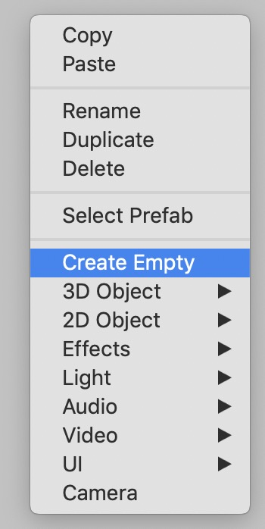
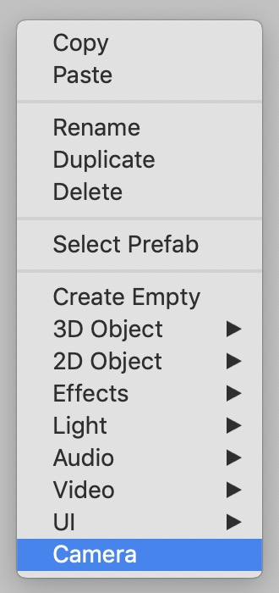
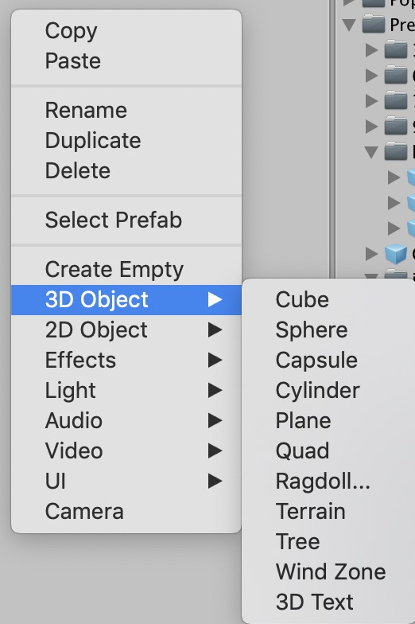
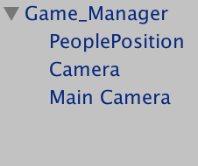
(1) Create Empty and name it as Game_Manager
(2) Create two cameras and name them as Main Camera and Camera
(2) Create a Cube name it as PeoplePosition

